Slide 1



PROJECT REPORT
DESKTOP APPLICATION DEVELOPMENT

Slide 2
TOPIC
BILLIARD MANAGEMENT PROGRAM

Slide 3





Meet Our Team
Lê Tấn Đạt
Nguyễn Viết Hóa
Nguyễn Ngọc Thịnh
195050974
215052247

Slide 4

Contributions
Lê Tấn Đạt
40%
Nguyễn Viết Hóa
40%
20%
Nguyễn Ngọc Thịnh

Slide 5


Table Of Content
Summary of project topic
Functional diagram
Technologies used
Database
Project Demo
Thank you

Slide 6


Summary of project topic
A "Billiards Table Management Program" is software designed for billiards clubs and entertainment centers. It streamlines operations, benefiting both staff and managers. Staff can manage table availability, process orders, and provide accurate bills. Managers can control tables, update the menu, monitor revenue, and manage employee accounts. This software improves customer service, operational efficiency, and overall business performance.

Slide 7





Functional diagram
Login functionality is the process by which users authenticate their identity by providing credentials such as a username and password to access a system or application.
Login
Manage account information
Manage guest playtime
The guest play time management feature in the billiards management software allows recording the time each customer uses the pool court
Adding (registering) new accounts, deleting unnecessary accounts, and correcting users' personal information.
Food management
Manage and track the food orders that customers place in the billiards
Allows customers to pay for services and products that they have used or purchased in the billiards bar.
Revenue management
Record, calculate and track all income from transactions, including proceeds from playing billiards, ordering food, beverages and other services
Payment

Slide 8
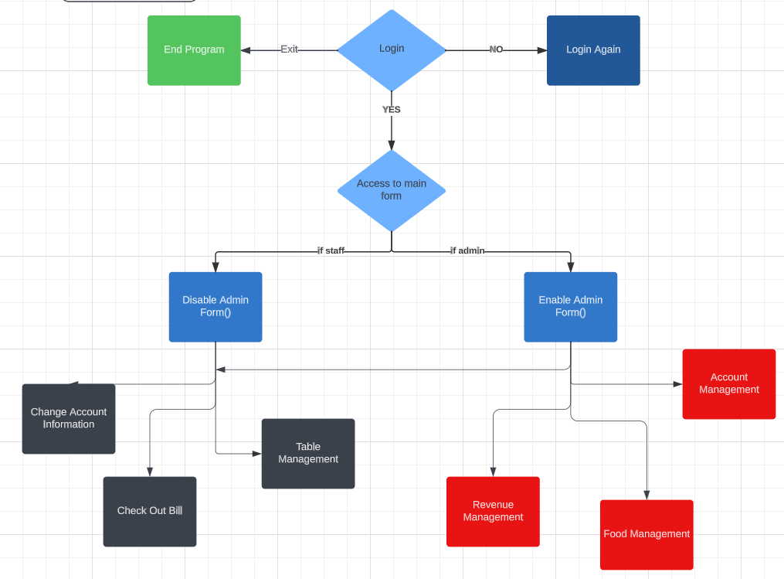
Functional diagram

Slide 9
Three layer model
Store Procedure
C#
Trigger
Technologies Used
SQL Server Management Studio
Visual Studio
Singleton pattern
Basic SQL

Slide 10
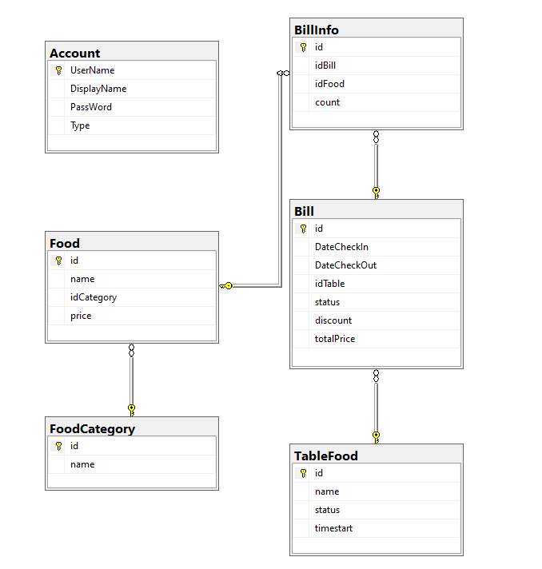
STT | TABLE NAME | DESCRIBE
1 | Account | Store login account information
2 | TableFood | Store login table information
3 | FoodCategory | Store login food category
4 | Food | Store food name and price
5 | Bill | Store bill
6 | BillInfo | Store bill each table
Database

Slide 11

Project Demo

Slide 12
THANK YOU

